Slide 1
Data Analysis and Statistics
Algebra 2
Chapter 11
Notes:
Algebra II 11

Slide 2
11.1 Find Measures of Central Tendency and Dispersion
Algebra 2
Chapter 11
Notes:
Algebra II 11

Slide 3
This Slideshow was developed to accompany the textbook
Larson Algebra 2
By Larson, R., Boswell, L., Kanold, T. D., & Stiff, L.
2011 Holt McDougal
Some examples and diagrams are taken from the textbook.
Slides created by
Richard Wright, Andrews Academy
rwright@andrews.edu

Slide 4
11.1 Find Measures of Central Tendency and Dispersion
Measure of central tendency
A number used to represent the center or middle of a set of data values.
Mean , or average, of n numbers is the sum of the numbers divided by n.
$$\overline{x}=\frac{x_{1}+x_{2}+…+x_{n}}{n}$$

Slide 5
11.1 Find Measures of Central Tendency and Dispersion
Median
middle number when the numbers are written in order. (If n is even, the median is the mean of the two middle numbers.)
Mode
number or numbers that occur most frequently. There may be one mode, no mode, or more than one mode.

Slide 6
11.1 Find Measures of Central Tendency and Dispersion
The winning scores of 6 baseball games are
5, 7, 8, 5, 10, 3
Find the mean, median, and mode.
Put the numbers in order 3, 5, 5, 7, 8, 10
Mean = $\frac{3+5+5+7+8+10}{6}=6.33$
Median = average of two middle numbers = $\frac{5+7}{2}=6$
Mode = 5
Notes:
Put the numbers in order 3, 5, 5, 7, 8, 10
Mean = $\frac{3+5+5+7+8+10}{6}=6.33$
Median = average of two middle numbers = $\frac{5+7}{2}=6$
Mode = 5

Slide 7
11.1 Find Measures of Central Tendency and Dispersion
Measure of dispersion
Statistic that tells you how dispersed, or spread out, data values are.
Range
difference between the greatest and least data values.
$$Range=max−min$$
Find the range of the following data sets.
14,17,18,19,20,24,30,32
$32−14=18$
8,11,12,16,18,18,18,20,23
$23−8=15$
Notes:
$$32−14=18$$
$$23−8=15$$

Slide 8
11.1 Find Measures of Central Tendency and Dispersion
Standard deviation
describes the typical differences (or deviation) between a data’s value and the mean.
$$σ=\sqrt{\frac{{(x_{1}−\overline{x})}^{2}+{(x_{2}−\overline{x})}^{2}+…+{(x_{n}−\overline{x})}^{2}}{n}}$$

Slide 9
11.1 Find Measures of Central Tendency and Dispersion
Find the standard deviation of the following data set.
4,8,12,15,3
Finding the standard deviation on a TI calculator
[STAT] → Edit, Enter data values in L1 (clear list first)
[STAT] → CALC → 1-Var Stats, [ENTER] x2 , Find $σ$x
Find the mean
$\frac{4+8+12+15+3}{5}=8.4$
$σ=\sqrt{\frac{{\left(4−8.4\right)}^{2}+{\left(8−8.4\right)}^{2}+{\left(12−8.4\right)}^{2}+{\left(15−8.4\right)}^{2}+{\left(3−8.4\right)}^{2}}{5}}$ $=4.59$
Notes:
Find the mean
$$\frac{4+8+12+15+3}{5}=8.4$$
$$σ=\sqrt{\frac{{\left(4−8.4\right)}^{2}+{\left(8−8.4\right)}^{2}+{\left(12−8.4\right)}^{2}+{\left(15−8.4\right)}^{2}+{\left(3−8.4\right)}^{2}}{5}}=4.59$$

Slide 10
11.1 Find Measures of Central Tendency and Dispersion
Outliers
Value that is much greater than or much less than most of the values in a data set.
Can skew measures of central tendency and dispersion

Slide 11
11.1 Find Measures of Central Tendency and Dispersion
Air Hockey You are competing in an air hockey tournament. The winning scores for the first 5 games are given below.
14,15,15,17,11
Find the mean, median, mode, range, and standard deviation of the data set.
$$\overline{x}=14.4, Med=15, Mode=15, Range=6, σ≈1.96$$
The winning score in the next game is an outlier, 25. Find the new mean, median, mode, range, and standard deviation.
$$\overline{x}=16.2, Med=15, Mode=15, Range=14, σ≈4.34$$
Which measure of central tendency does the outlier affect the most? the least?
The mean is most affected by the outlier. The mode is least affect by the outlier.
What effect does the outlier have on the range and standard deviation?
The outlier causes both the range and standard deviation to increase.
Notes:
$\overline{x}=14.4, Med=15, Mode=15, Range=6, σ≈1.96$
$\overline{x}=16.2, Med=15, Mode=15, Range=14, σ≈4.34$
The mean is most affected by the outlier. The mode is least affect by the outlier.
The outlier causes both the range and standard deviation to increase.

Slide 12
11.1 Find Measures of Central Tendency and Dispersion
On the homework, do one standard deviation by hand. You can use your calculator to do the rest.

Slide 13
Quiz
11.1 Homework Quiz

Slide 14
11.2 Apply Transformations to Data
Algebra 2
Chapter 11
Notes:
Algebra II 11

Slide 15
This Slideshow was developed to accompany the textbook
Larson Algebra 2
By Larson, R., Boswell, L., Kanold, T. D., & Stiff, L.
2011 Holt McDougal
Some examples and diagrams are taken from the textbook.
Slides created by
Richard Wright, Andrews Academy
rwright@andrews.edu

Slide 16
11.2 Apply Transformations to Data
Adding a Constant to Data Values
When a constant is added to every value in a data set, the following are true:
The mean, median, and mode of the new data set can be obtained by adding the same constant to the mean, median, and mode of the original data set.
The range and standard deviation are unchanged.

Slide 17
11.2 Apply Transformations to Data
The data below give the weights of 5 people. At the end of a month, each person had lost 3 pounds. Give the mean, median, mode, range, and standard deviation of the starting weights and the weights at the end of the month.
138, 142, 155, 140, 155
Mean: 146
Median: 142
Mode: 155
Range: 17
Std. Dev.: 7.46
$$−3=143$$
$$−3=139$$
$$−3=152$$
$$unchanged=152$$
$$unchanged=7.46$$
Notes:
Mean: 146 and 143 (minus 3)
Median: 142 and 139 (minus 3)
Mode: 155 and 152 (minus 3)
Range: 17 and 17 (unchanged)
Std. Dev.: 7.46 and 7.46 (unchanged)

Slide 18
11.2 Apply Transformations to Data
Multiplying Data Values by a Constant
When each value of a data set is multiplied by a positive constant, the new mean, median, mode, range, and standard deviation can be found by multiplying each original statistic by the same constant.

Slide 19
11.2 Apply Transformations to Data
The data below give the weights of 5 people. Give the mean, median, mode, range, and standard deviation for the weights of the 5 people in kilograms.
(Note: 1 pound ≈ 0.45 kilogram)
138, 142, 155, 140, 155
Find the mean, median, mode, range, SD in lbs (see previous example for these numbers)
Mean: 146
Median: 142
Mode: 155
Range: 17
SD: 7.46
$$×0.45=65.7$$
$$×0.45=63.9$$
$$×0.45=69.75$$
$$×0.45=7.65$$
$$×0.45=3.36$$
Notes:
Find the mean, median, mode, range, SD in lbs (see previous example for these numbers)
Mean: 146
Median: 142
Mode: 155
Range: 17
SD: 7.46
Multiply these by 0.45 to get them in kg
Mean: 65.7
Median: 63.9
Mode: 69.75
Range: 7.65
Std. Dev.: 3.36

Slide 20
Quiz
11.2 Homework Quiz

Slide 21
11.3 Use Normal Distributions
Algebra 2
Chapter 11
Notes:
Algebra II 11

Slide 22
This Slideshow was developed to accompany the textbook
Larson Algebra 2
By Larson, R., Boswell, L., Kanold, T. D., & Stiff, L.
2011 Holt McDougal
Some examples and diagrams are taken from the textbook.
Slides created by
Richard Wright, Andrews Academy
rwright@andrews.edu

Slide 23
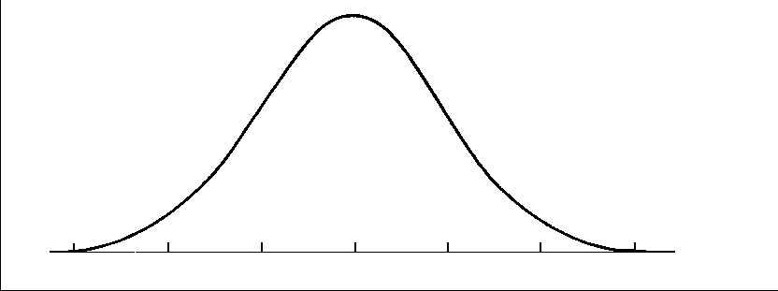
11.3 Use Normal Distributions
A normal distribution is modeled by a bell-shaped curve called a normal curve that is symmetric about the mean.

Slide 24
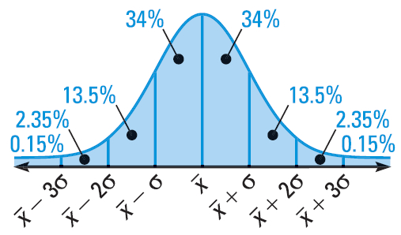
11.3 Use Normal Distributions
A normal distribution with mean $\overline{x}$ and standard deviation $σ$ has the following properties:
The total area under the related normal curve is 1.
About 68% of the area lies within 1 standard deviation of the mean.
About 95% of the area lies within 2 standard deviations of the mean.
About 99.7% of the area lies within 3 standard deviations of the mean.

Slide 25
11.3 Use Normal Distributions
A normal distribution has mean and standard deviation. For a randomly selected x-value from the distribution, find P($\overline{x}−σ≤x≤\overline{x}+3σ$)
Add the percents between the lines marked $\overline{x}−σ$ and $\overline{x}+3σ$
$34\%+34\%+13.5\%+2.35\%$
$83.85\%$
Notes:
P($\overline{x}−σ≤x≤\overline{x}+3σ$) = 0.8385

Slide 26
11.3 Use Normal Distributions
The weight of strawberry packages is normally distributed with a mean of 16.18 oz and standard deviation of 0.34 oz. If you randomly choose 2 containers, what is the probability that both weigh less than 15.5 oz?
$15.5=16.18−2\left(0.34\right)=\overline{x}−2σ$
Add the percents for the areas below $\overline{x}−2σ$
$P\left(≤15.5\right)=0.15\%+2.35\%=2.5\%=0.025$
We want two packages, so multiply the individual probabilities
$P(≤15.5)P(≤15.5)=0.025(0.025)=0.000625$
Notes:
$$15.5=16.18−2\left(0.34\right)=\overline{x}−2σ$$
Add the percents for the areas below $\overline{x}−2σ$
$$P\left(≤15.5\right)=0.15\%+2.35\%=2.5\%=0.025$$
We want two packages, so multiply the individual probabilities
$$P(≤15.5)P(≤15.5)=0.025(0.025)=0.000625$$

Slide 27
11.3 Use Normal Distributions
The standard normal distribution is the normal distribution with mean = 0 and standard deviation = 1.
Formula = $z=\frac{x−\overline{x}}{σ}$
The z value for a particular x-value is called the z-score for the x-value and is the number of standard deviations the x-value lies above or below the mean $\overline{x}$.

Slide 28
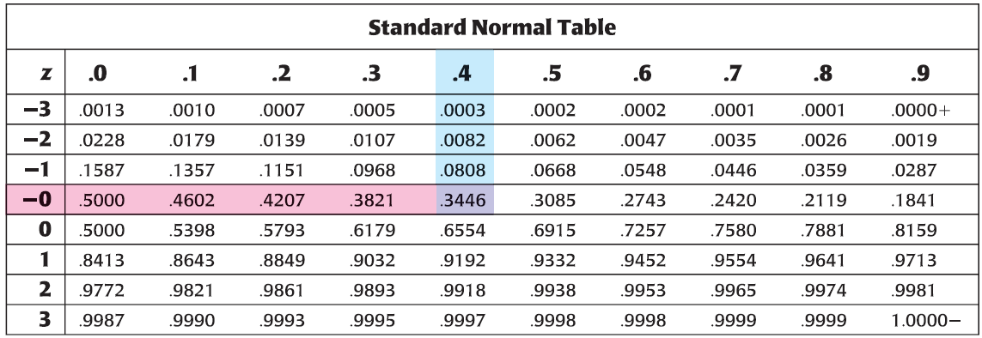
11.3 Use Normal Distributions
If a z-score is known, the probability of that value or less can be found from a Standard Normal Table.
P(z ≤ -0.4) = 0.3446

Slide 29
11.3 Use Normal Distributions
Finding Probabilities with Z-scores using a TI-graphing calculator
use the normalcdf function. It computes P($z_{1}<z<z_{2}$), which is the area under the standard normal curve between $z_{1}andz_{2}$.
To calculate P($−1<z<2$), press 2nd DISTR, normalcdf( and then press ENTER.
After normalcdf( type -1 , 2 ) and then press ENTER.
If you want $P(z<2)$ do normalcdf(-100,2)
If you want $P(z>2)$ do normalcdf(2, 100)
normalcdf(-1,2) = 0.8186
Notes:
If want P(z ≤ n), let z₁ = -100 and z₂ = n

Slide 30
11.3 Use Normal Distributions
A survey of 20 colleges found that the average credit card debt for seniors was $3450. The debt was normally distributed with a standard deviation of $1175. Find the probability that the credit card debt of the seniors was at most $3600.
Step 1: Find the z-score corresponding to an x-value of $3600.
$z=\frac{x−\overline{x}}{σ}$
$\frac{3600−3450}{1175}=0.13$
Step 2: Use the table or normalcdf to find P($x≤\$3600$).
P($z≤0.13$) = 0.5508
Notes:
Z-score = $z=\frac{x−\overline{x}}{σ}=\frac{3600−3450}{1175}=0.13$
P($z≤0.13$) = 0.5508

Slide 31
Quiz
11.3 Homework Quiz

Slide 32
11.4 Select and Draw Conclusions from Samples
Algebra 2
Chapter 11
Notes:
Algebra II 11

Slide 33
This Slideshow was developed to accompany the textbook
Larson Algebra 2
By Larson, R., Boswell, L., Kanold, T. D., & Stiff, L.
2011 Holt McDougal
Some examples and diagrams are taken from the textbook.
Slides created by
Richard Wright, Andrews Academy
rwright@andrews.edu

Slide 34
11.4 Select and Draw Conclusions from Samples
Population
A group of people or objects that you want information about.
Sample
When it is too hard to work with everything, information is gathered from a subset of the population.
There are 4 types of samples:
Self-selected – member volunteer
Systematic – rule is used to select members
Convenience – easy-to-reach members
Random – everyone has equal chance of being selected

Slide 35
11.4 Select and Draw Conclusions from Samples
A manufacturer wants to sample the parts from a production line for defects. Identify the type of sample described.
The manufacturer has every 5th item on the production line tested for defects.
Systematic
The manufacturer has the first 50 items on the production line tested
Convenience
Notes:
Systematic
Convenience

Slide 36
11.4 Select and Draw Conclusions from Samples
Unbiased Sample
Ensure accurate conclusions about a population from a sample.
An unbiased sample is representative of the population.
A sample that over- or underrepresents part of the population is a biased sample.
Although there are many ways of sampling a population, a random sample is preferred because it is most likely to be representative of the population.

Slide 37
11.4 Select and Draw Conclusions from Samples
A magazine asked its readers to send in their responses to several questions regarding healthy eating. Tell whether the sample of responses is biased or unbiased. Explain.
The sample is biased because only readers with strong opinions will respond.
Notes:
Possible response: The sample is biased because only readers with strong opinions will respond.

Slide 38
11.4 Select and Draw Conclusions from Samples
The owner of a company with 300 employees wants to survey them about their preference for a regular 5-day, 8-hour workweek or a 4-day, 10-hour workweek. Describe a method for selecting a random sample of 50 employees to poll.
Example answer: Placing the names in a hat and choosing 50 at random.
Notes:
Possible solution: Placing the names in a hat and choosing 50 at random. Solutions may vary, but the sampling method must be random.

Slide 39
11.4 Select and Draw Conclusions from Samples
Sample Size
When conducting a survey, the larger the sample size is, the more accurately the sample represents the population.
As the sample size increases, the margin of error decreases.
Margin of error
Gives a limit on how much the responses of the sample would differ from the responses of the population.
For a sample size n, the margin of error is:
Margin of error = $±\frac{1}{\sqrt{n}}$

Slide 40
11.4 Select and Draw Conclusions from Samples
Survey In a survey of 1535 people, 48% preferred Brand A over Brand B and Brand C.
What is the margin of error for the survey?
Margin of error = $±\frac{1}{\sqrt{n}}$
$±\frac{1}{\sqrt{1535}}=±0.026 or ±2.6\%$
Give an interval that is likely to obtain the exact percent of all people who prefer Brand A.
Take the average and $±$margin of error
$48\%±2.6\%$
Between 45.4% and 50.6%
Notes:
Margin of error = $±\frac{1}{\sqrt{n}}$
$$±\frac{1}{\sqrt{1535}}=±0.026 or ±2.6\%$$
b. Take the average and $±$margin of error
$$48\%±2.6\%$$
Between 45.4% and 50.6%

Slide 41
11.4 Select and Draw Conclusions from Samples
A polling company conducts a poll for a U.S. presidential election. How many people did the company survey if the margin of error is $±3\%$?
$Margin of error= ±\frac{1}{\sqrt{n}}$
$±0.03=±\frac{1}{\sqrt{n}}$
$0.03=\frac{1}{\sqrt{n}}$
$0.03\sqrt{n}=1$
$\sqrt{n}=\frac{1}{0.03}$
$n={\left(\frac{1}{0.03}\right)}^{2}=1111.11$
N = 1111 people
Notes:
$$Margin of error= ±\frac{1}{\sqrt{n}}$$
$$±0.03=±\frac{1}{\sqrt{n}}$$
$$0.03=\frac{1}{\sqrt{n}}$$
$$0.03\sqrt{n}=1$$
$$\sqrt{n}=\frac{1}{0.03}$$
$$n={\left(\frac{1}{0.03}\right)}^{2}=1111.11$$
N = 1111 people

Slide 42
Quiz
11.4 Homework Quiz

Slide 43
11.5 Choose the Best Model for Two-Variable Data
Algebra 2
Chapter 11
Notes:
Algebra II 11

Slide 44
This Slideshow was developed to accompany the textbook
Larson Algebra 2
By Larson, R., Boswell, L., Kanold, T. D., & Stiff, L.
2011 Holt McDougal
Some examples and diagrams are taken from the textbook.
Slides created by
Richard Wright, Andrews Academy
rwright@andrews.edu

Slide 45
11.5 Choose the Best Model for Two-Variable Data
To find the best model for a set of data pairs (x, y)…
Make a scatter plot
Determine the function suggested by the plot
Linear
$y=ax+b$

Slide 46
11.5 Choose the Best Model for Two-Variable Data
Quadratic
$y=ax^{2}+bx+c$
Cubic
$$y=ax^{3}+bx^{2}+cx+d$$

Slide 47
11.5 Choose the Best Model for Two-Variable Data
Exponential
$y=ab^{x}$
Power
$y=ax^{b}$

Slide 48
11.5 Choose the Best Model for Two-Variable Data
To graph data on TI-Graphing Calculator
STAT → Edit…
Clear lists by highlighting L1 (or L2) and push CLEAR
Enter x-values in L1 and y-values in L2
Push Y= → clear any equations
In Y= hightlight Plot 1 and push ENTER
To zoom push ZOOM → ZoomStat
Choose type of graph (linear, quadratic, cubic, exponential, power)
This can be done on Excel if you don’t have a graphing calculator.

Slide 49
11.5 Choose the Best Model for Two-Variable Data
To see your regression with your data points
Select the type the regression from STAT→CALC
Specify the x-data (2nd L1)
Comma
Specify the y-data (2nd L2)
Comma
Name the regression Y1 (VARS→Y-VARS→Function…→Y1)
You should see “yourReg L1, L2, Y1”
Push Enter
Push Graph
This can be done on Excel if you don’t have a graphing calculator.

Slide 50
11.5 Choose the Best Model for Two-Variable Data
Microsoft Excel
Enter your data in two columns
Highlight the columns and click Insert → Scatter
You should now have a scatter plot
To get a regression
Select your graph and click Chart Tools Layout → Trendline → More Trendline Options
Select your regression type (quadratic is polynomial order 2, cubic is polynomial order 3)
Checkmark the Display Equation on Chart box
Click OK and your regression and equation will be on the graph

Slide 51
11.5 Choose the Best Model for Two-Variable Data
The table shows the cost of a meal x (in dollars) and the tip y (in dollars) for parties of 6 at a restaurant. Find a model for the data.
x | 34.48 | 52.54 | 89.64 | 100.76 | 65.60 | 109.34
y | 5.5 | 11 | 15 | 16 | 12 | 21
Notes:
Could be linear or cubic (situation suggests linear)
$$y=0.17x+0.44$$

Slide 52
11.5 Choose the Best Model for Two-Variable Data
The table shows amount y of money in your savings account after x weeks.
x | y
0 | 0
1 | 200
2 | 250
3 | 300
4 | 300
5 | 300
6 | 315
7 | 340
8 | 405
Notes:
Cubic y = 3.2365x³ - 44.899x² + 201.81x + 12.172

Slide 53
Quiz
11.5 Homework Quiz

